Slide 1

Lecture
on
“Advanced Computer Architecture –TCS 704”
by
Akansha Gupta
DEPARTMENT OF COMPUTER SCIENCE AND ENGINEERING
GRAPHIC ERA DEEMED TO BE UNIVERSITY – 248002

Slide 2
BRANCH PREDICTION

Slide 3
Branch prediction
Resolve a branch hazard by predicting which path will be taken
• Execute under that assumption
• Flush the wrong-path instructions from the pipeline & fetch the right path if wrong
Performance improvement depends on
• whether the prediction is correct (here’s most of the innovation)
• how soon you can check the prediction

Slide 4
Dynamic branch prediction
Dynamic Branch Prediction:
• the prediction changes as program behavior changes
• branch prediction implemented in hardware
• common algorithm based on branch history
• predict the branch taken if branched the last time
• predict the branch not-taken if didn’t branch the last time
Alternative: static branch prediction
• compiler-determined prediction
• fixed for the life of the program
• an algorithm?

Slide 5
Branch Prediction Buffer
Branch prediction buffer
• small memory indexed by the lower bits of the address of a branch instruction during the fetch stage
• contains a prediction (which path the last branch to index to this BPB location took)
• do what the prediction says to do
• if the prediction is taken & it is correct
• only incur a one-cycle penalty
• if the prediction is not taken & it is correct
• incur no penalty
• if the prediction is incorrect
• change the prediction
• also flush the pipeline
• penalty is the same as if there were no branch prediction

Slide 6
Branch Predictor
Example:
for(i=0;i<5;i++){
a+=1;
}
i 0 1 2 3 4 5 0 1
T T T T T N T T
1-bit D D D D D ND ND D
2-bit D D D D D ND D D

Slide 7
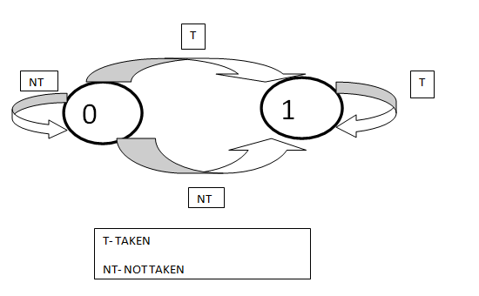
One-bit Branch Predictor

Slide 8
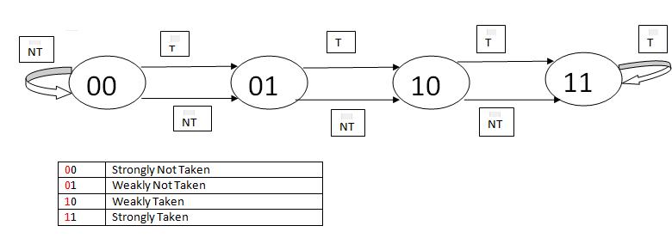
Two-bit Branch Predictor

Slide 9
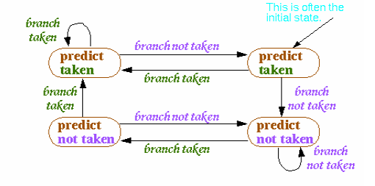
Two-bit Prediction
A single prediction bit does not work well with loops
• mispredicts the first & last iterations of a nested loop
Two-bit branch prediction for loops
• Algorithm: have to be wrong twice before the prediction is changed

Slide 10
Branch Prediction is More Important Today
Conditional branches still comprise about 20% of instructions Correct predictions are more important today
• pipelines deeper
branch not resolved until more cycles from fetching therefore the misprediction penalty greater
• cycle times smaller: more emphasis on throughput (performance)
• more functionality between fetch & execute
• multiple instruction issue (superscalar & VLIW)
branch occurs almost every cycle
• flushing & refetching more instructions
• object-oriented programming
more indirect branches which harder to predict
• dual of Amdahl’s Law
other forms of pipeline stalling are being addressed so the portion of CPI due to branch delays is relatively larger
All this means that the potential stalling due to branches is greater

Slide 11
Directions in Branch Prediction
1: Improve the prediction
• correlated (2-level) predictor (Pentiums)
• hybrid local/global predictor (Alpha)
2: Determine the target earlier
• branch target buffer (Pentium, Itanium)
• next address in I-cache (Alpha, UltraSPARC)
• return address stack (everybody)
3: Reduce misprediction penalty
• fetch both instruction streams (IBM mainframes)
4: Eliminate the branch
• predicated execution (Itanium)

Slide 12
https://youtu.be/55PiIQD1iGY
THANKS

